Slide 1


Support Vector Regression
June, 2024
Group 5

Slide 2
C
ONTENTS
01
Introduction
02
单击添加文本

Slide 3
01
Introduction

Slide 4
SVM & SVR
Support Vector Machine (SVM) is a powerful learning algorithm that solves linearly separable problems by finding a linear classification model that minimizes the number of support vectors and the distance between hyperplanes.
With the successful application of SVM in multiple fields, people have begun to attempt to extend SVM to regression problems, resulting in Support Vector Regression (SVR).The core idea of SVR is to construct a separation hyperplane by searching for support vectors, thereby achieving modeling of uncertain functional relationships.
Practical applications:
Data mining
Prediction
Classification
Clustering

Slide 5
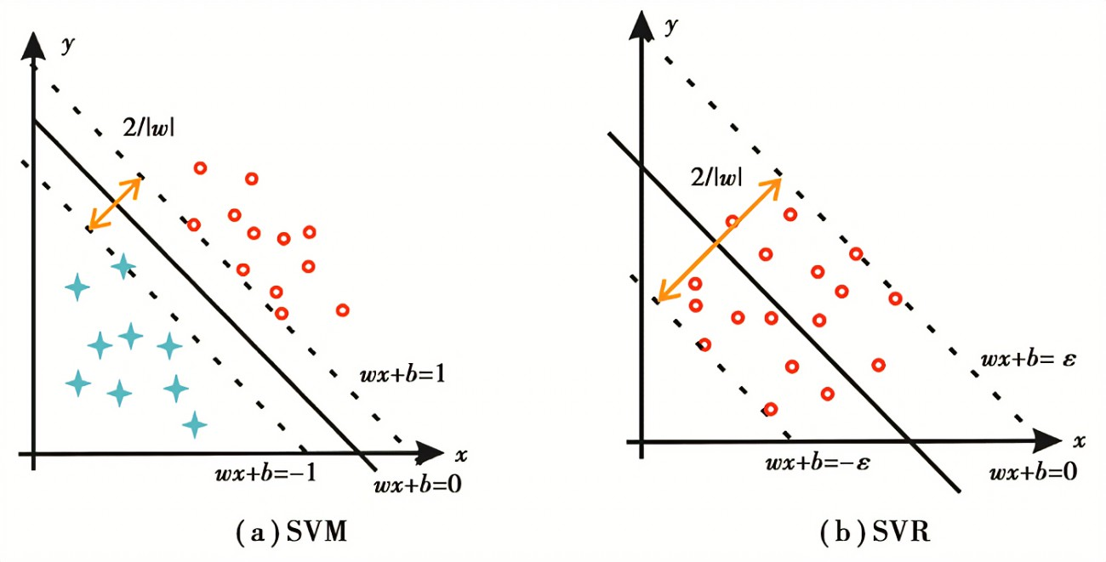
Support Vector Regression
SVR is a nonlinear regression method that models nonlinear relationships by mapping the original problem to a high-dimensional space and then finding a linearly separated hyperplane in that space.The core idea of SVR is to construct a separate hyperplane by finding support vectors, so as to realize the modeling of uncertain functional relations.
SVR is an extension of SVM. It extends the linear separable problem to regression problem.
SVM is to maximize the "distance" from the nearest sample point to the hyperplane.
SVR is to minimize the "distance" from the nearest sample point to the hyperplane.

Slide 6
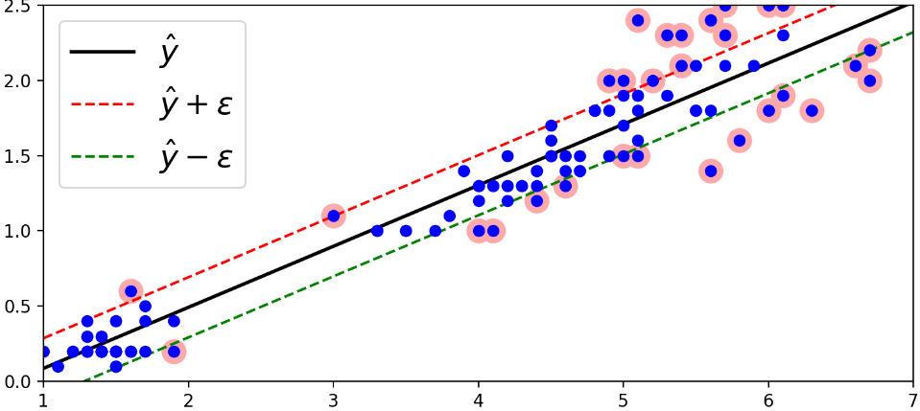
SVR Principle
SVR creates an "interval band" on both sides of the linear function, the interval is ϵ (ϵ is also known as tolerance deviation, which is an empirical value set manually). No loss is calculated for all samples falling into the interval band, that is, only the support vector can affect the function model. Finally, the optimized model is obtained by minimizing the total loss and maximizing the interval.
As shown in the following figure:
The samples in the "pipeline" are non-support vectors;
The boundary support vector located on the "tube wall" is the boundary support vector.
Those outside the "pipeline" are non-boundary support vectors
In anomaly detection, exceptions are often selected from non-boundary support vectors
​
Notes:
围绕2021年度的工作目标，我们已经完成了80%的工作

Slide 7
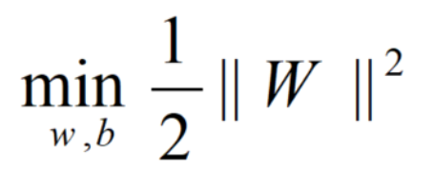
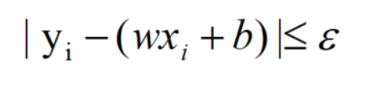
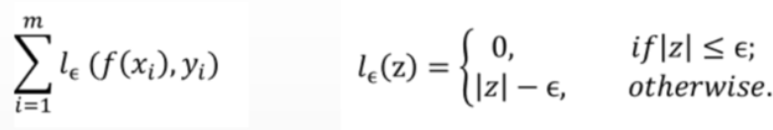
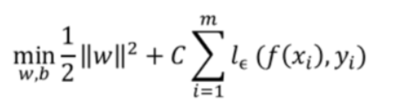
SVR Mathematical Model
Linear hard interval SVR:
SVR optimization goals:
The point within the boundary satisfies the conditions:
The loss function of SVR is:
Thus the SVR problem can be formalized as:
Notes:
围绕2021年度的工作目标，我们已经完成了80%的工作

Slide 8
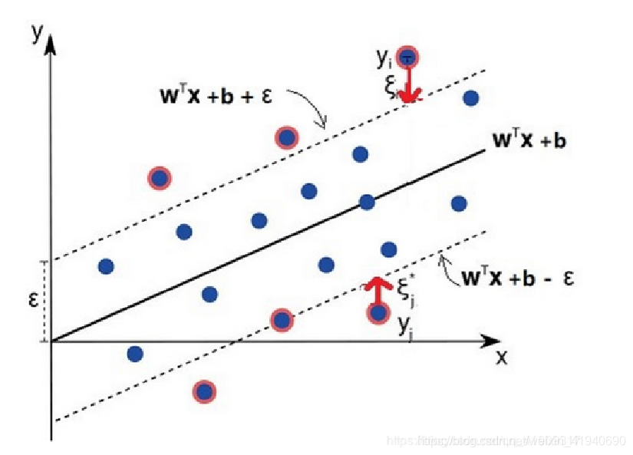
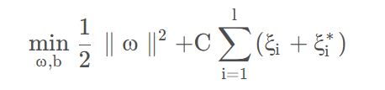
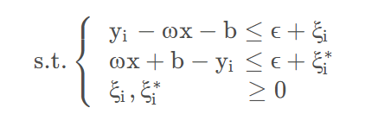
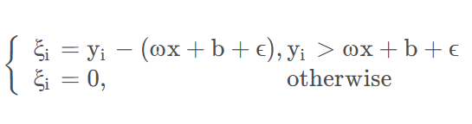
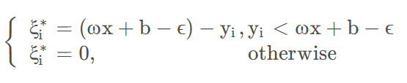
SVR Mathematical Model
Linear soft interval SVR:
In real tasks, it is often difficult to directly determine the appropriate ϵ to ensure that most data can be in the interval band, and SVR expects all training data to be in the interval band, so the relaxation variable ξ_{i} and ξ_{i} * are added to make the interval requirement of the function relaxed, that is, some samples are allowed not to be in the interval band.
SVR objective function:
The value of ξ_{i} and ξ_{i} * can be:

Slide 9
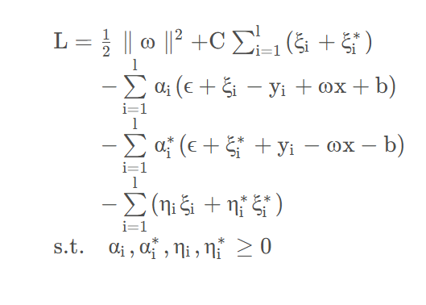
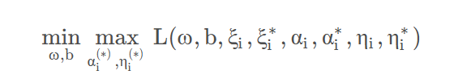
SVR Mathematical Model
Linear soft interval SVR:
In order to minimize the objective function, the Lagrange function is constructed according to the constraints:
The original problem can be reduced to:

Slide 10
Group Members
Theoretical Section
Shi Jinsong 施劲松 (Presenter)
Li Cunhao 李存浩
Zhang Chaoyang 张朝阳
Liu Xuechun 刘雪纯
Coding Section
Mahfuz 罗尼 (Presenter)
Dong Bowen 董博文
Wang Yifan 王亦帆
JACOBO BUSUMABU

Slide 11
谢谢大家
June, 2024
group 5

